Slide 1
Automation and Optimizition of Genome Construction Process
Anby Zhou
Notes:
Kio ria, good morning, everyone, My name is Anby, almost finish Master of IT, and from Bioinformatic Analysis team at PFR. My project is to automate and optimize genome construction process.

Slide 2
AGENDA
Background
Contribution
01
04
Research Goal
Future Work
02
05
Design & Method
03

Slide 3
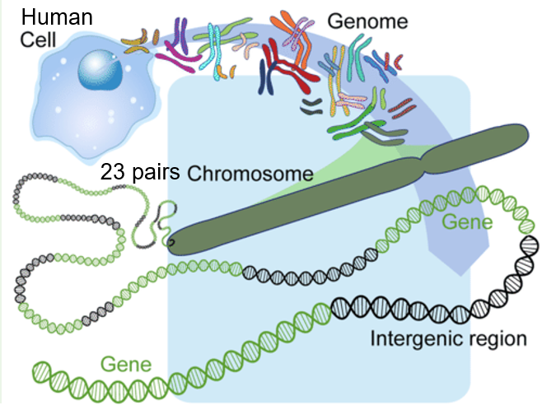
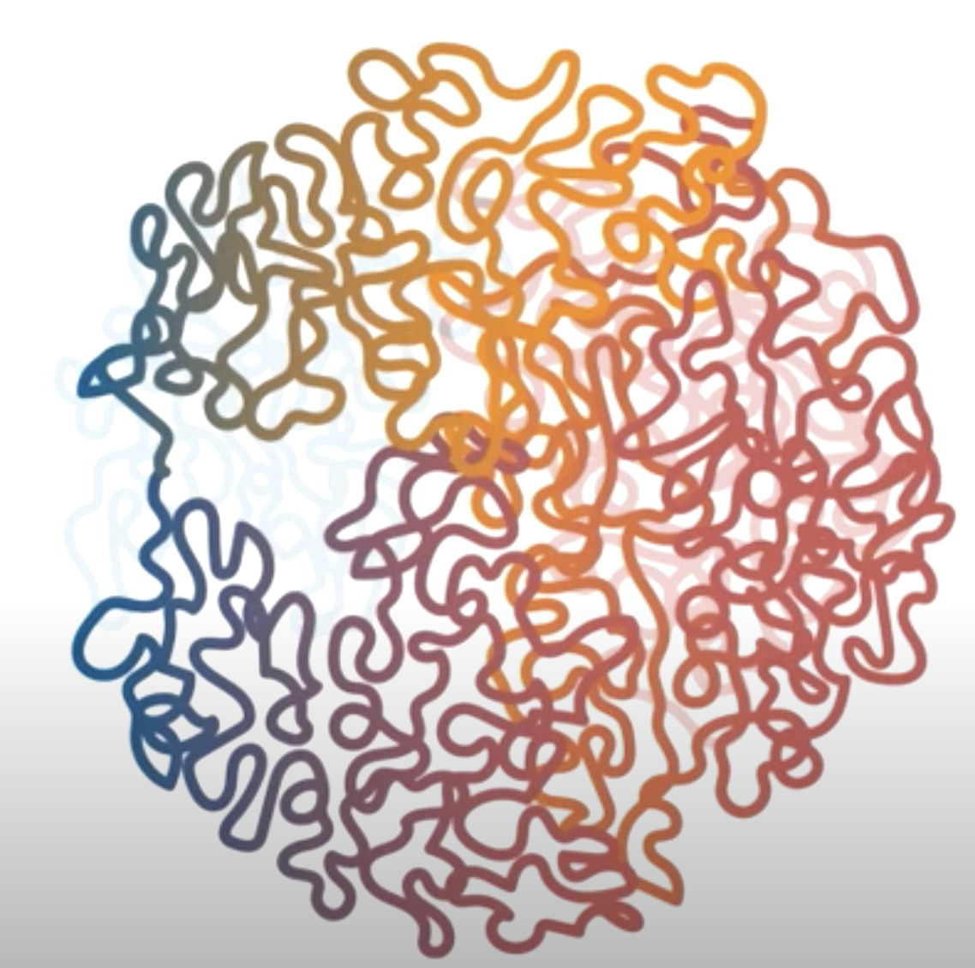
Background
What is Genome?
A genome is an organism’s complete set of genetic instructions.
Notes:
For example: human body (genome is a recipe book of our body)
Each cell with their own complete set of instructions for making us, like a recipe book for the body. This set of instructions is known as our genome.

Slide 4
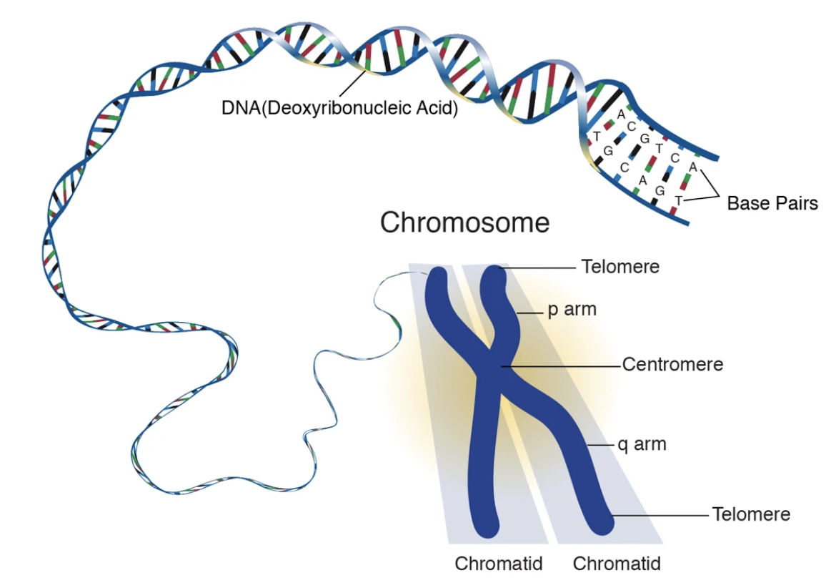
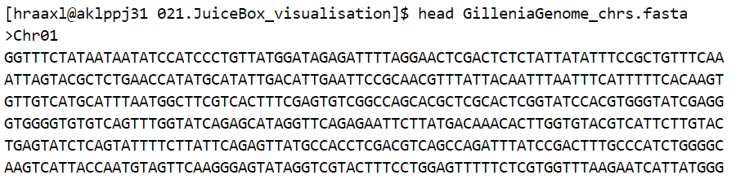
Background
How does chromosome look like?
How do we store chromosome on computer?

Slide 5
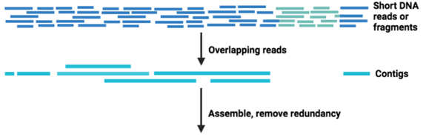
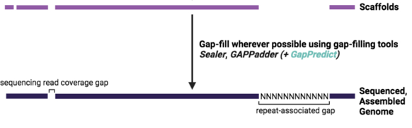
Background
Why need genome assembly?
Complete reference genome is fundamental for the application of genomics to biology
Current sequencing machines can only generate small pieces of genome
Genome assembly is the process to put small sequences together into the right order and orientation
Building a high-quality genome is a complicated process including extensive time and human efforts​
Contig
Notes:
Current third-generation sequencing technologies, such as Oxford Nanopore and PacBio HiFi, only improved the continuity of assembly.
However, accurate assembly of large and complex plant and animal genomes at the chromosomal level is highly required!
Because

Slide 6
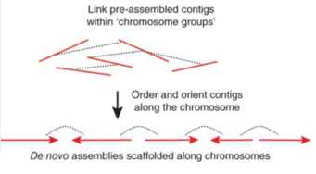
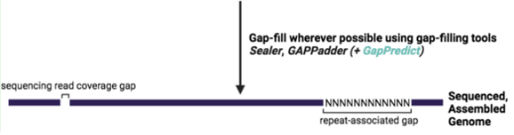
Background
What is Hi-C?
Long-range linked read pairs to bridge long gaps.
Regions that are closer on genome are generally closer in spatial structure.
Having different tools:
Scaffolders
Hi-C
R1
R2
Notes:
long-range linked data is still required to accurately bridge gaps in assembly to enable accurate assembly of large and complex plant and animal genomes at the chromosomal level.
Therefore, Chromosome conformation capture techniques that have been developed, such as Hi-C. Also, Hi-C tools like Yahs, Salsa and AllHic are developed.
More interaction frequencies between 2 neibouring contigs
A pair of R1 and R2 represents 1 interaction between 3D structure of genome

Slide 7
Previous Difficulties
No scaffolding process optimized for assembling the genome of non-model organisms.
Maximum 2 scaffolders
unknown input data volume
Mostly use default parameters
No summary of final result
No standard evaluation method
No automation process
No computing resource usage report
Intensive manual curation steps
Notes:
Current Hi-C scaffolder for sequencing the genome is based on human genome (model organism).
However, these tools are less sensitive
when applied to non-model organisms,
such as plants data which are much more
diverse and complex.

Slide 8
Research Goal
Automate genome assembly process
2. Hi-C scaffolders benchmarking targeting on non-model organisms
3. Evaluation method
4. Build comprehensive report
Notes:
The gap is these tools are developed using human chromosome data, and less sensitive when applied to non-model organisms, such as plants chromosome data which are much more diverse and complex.
How can we find the most suitable Hi-C scaffolder through scaffolder benchmarking to do fast and accurate chromosome assembly for non-model organisms?
Find the most suitable Hi-C scaffolder for
non-model organism's genome assembly
through scaffolder
Benchmarking:
Scaffolder (the number of scaffolds, size, heatmap)
Input data (output data similar?)
Computing resource
Lab protocol

Slide 9
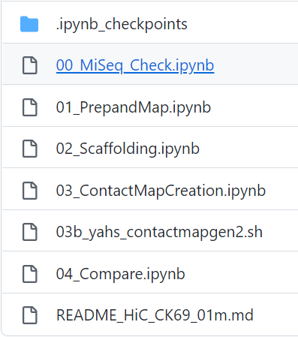
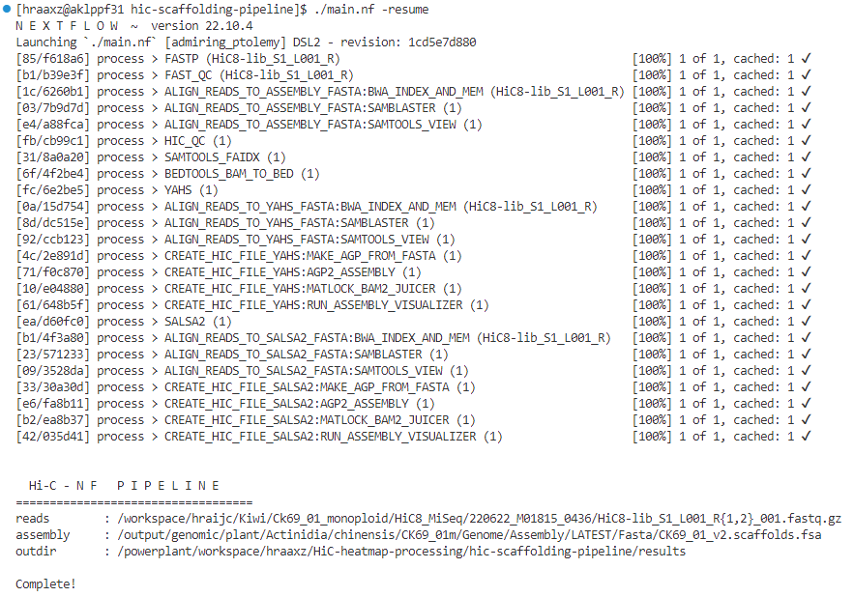
Design & Method
Traditional way at PFR
Automation way NOW
Automation: Streamlining the whole process
Notes:
3 stages:
qc (input data quality check)
Scaffolding
Benchmarking

Slide 10
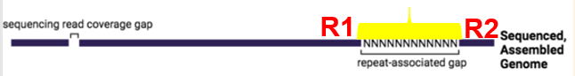
Design & Method
R1
R2
Stage 1: Input data quality check
Quality Check
Fastp (Filter)
Contig
Cleaned R1
Cleaned R2
Contigs
Hic qc (Quality Check)
Mapped file
Notes:
3 stages:
qc (input data quality check)
Scaffolding
Benchmarking

Slide 11
Design & Method
Stage 2: Do Hi-C scaffolding for
genome assembly
Stage 1
Hi-C Scaffolding
Mapped file
Contig
Scaffolding
Report
Notes:
3 stages:
qc (input data quality check)
Scaffolding
Benchmarking

Slide 12
Design & Method
Stage 3: Do Hi-C scaffolder
benchmarking
Mapped file
Scaffolders
Yahs
Salsa2
ALLHic
3D-DNA
Visualisation & Evaluation
Final report
Notes:
Non-model organism: e.g. Plants

Slide 13
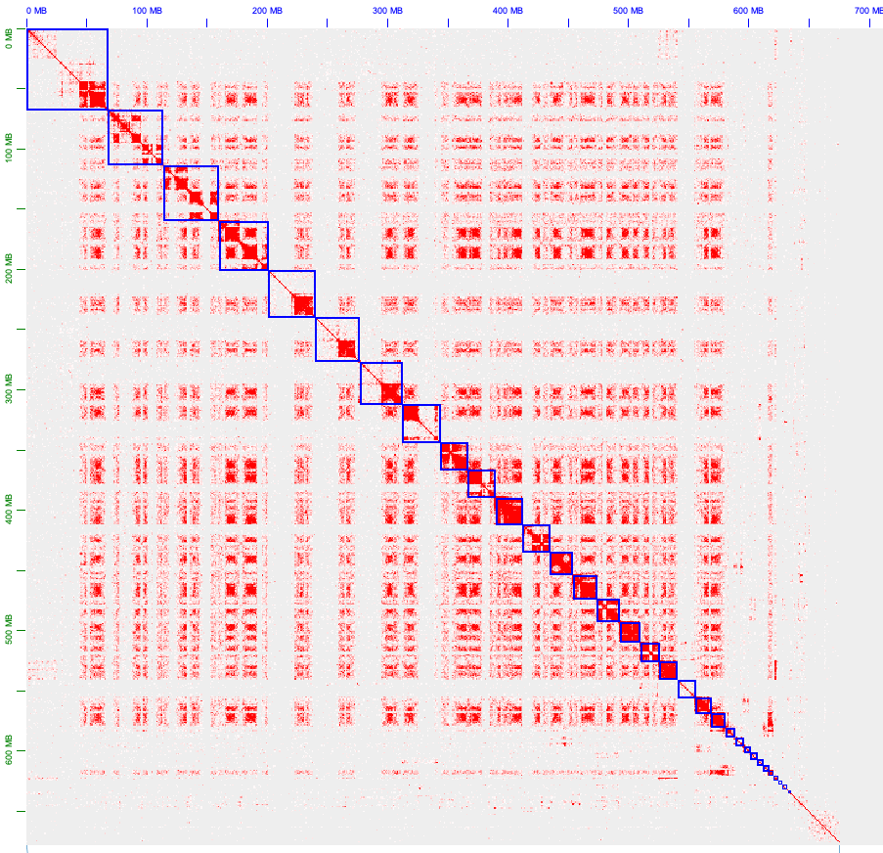
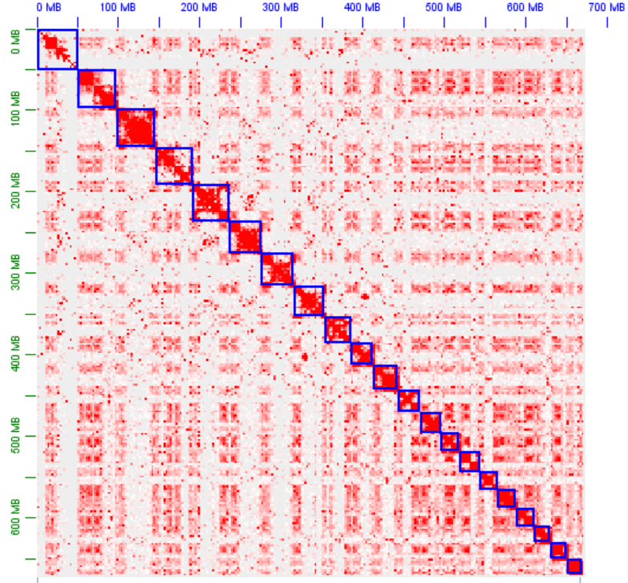
Visualisation & Evaluation
Bad Result: Good Result:
Notes:
Strong signal & weak signal
much higher frequency of interactions between the genomic regions that are close to each other.
Frequency of off diagonal signals. The stronger diagonal signals line up on the diagonal, the better result scaffolder produce.

Slide 14
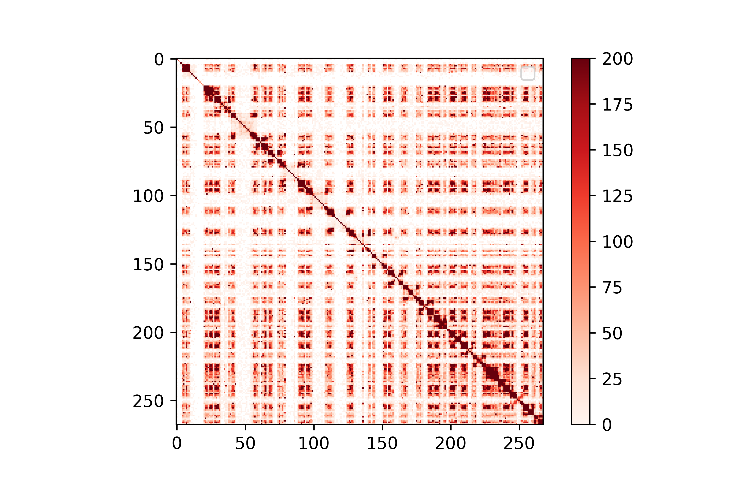
Evaluation
Compare scaffolding results from different scaffolders:
With the result (matrix files) from scaffolders, the matrices are diagonal-like,
with higher values at and around the diagonal.
The idea is to score the matrix file.
Notes:
Heatmap is used for evaluating scaffolding accuracy.
A lot more dots are sitting close to the diagonal on the heatmap because much higher frequency of interactions between the genomic regions that are close to each other.
which comes from different scaffolders on how much the higher entries cluster in and around the diagonal

Slide 15
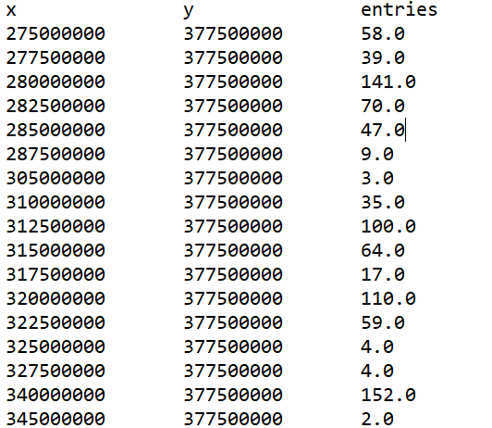
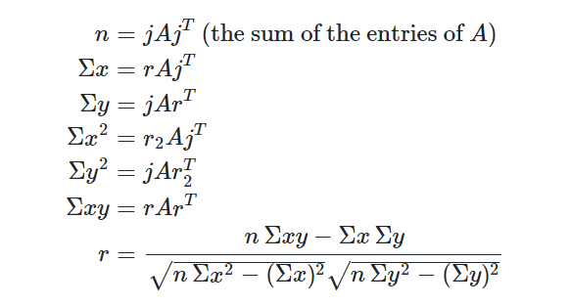
Design & Method
Let A be a d × d matrix; let j be the d-long vector of all ones, and let r=(1,2,…,d), and r2=(12,22,…,d2). Then:
Notes:
Given that your entries are frequencies, and you want to give credit for being "close" to the diagonal, a natural approach is to compute the correlation coefficient between the row and column. That is, suppose your matrix is built as follows: repeatedly generate a pair of numbers x and y, and increment the count of the matrix entry at position (x,y). If you think of x and y as samples of random variables X and Y respectively, then the sample correlation coefficient r of X and Y lies between −1 and 1. It is 1 if X and Y are perfectly correlated, −1 if they are perfectly anticorrelated.

Slide 16
Final report
https://qzho906.wixsite.com/hi-c-pipeline-final
https://storage.powerplant.pfr.co.nz/workspace/hraaxz/HiC-pipeline-runs/Prunus_salicina_Plum_HiC_hap1/HiC-heatmap-processing/hiC_pipeline/Prunus-salicina-Plum-HiC-hap1-report.html
Notes:
3 stages:
qc (input data quality check)
Scaffolding
Benchmarking

Slide 17
Contribution to real case
Streamlining the whole Hi-C scaffolding process, which at least saves 83% time.
Saves computing resource, with a clear resource usage report.
Saves Human resource, non-expert can easily use.
Optimized the process of figuring out the most suitable scaffolder(tool) for non-model organisms genome assembly.

Slide 18
Thank you !
Anby.Zhou@plantandfood.co.nz

